Slide 1
Why We’re Moving to Jupyter
An Exploratory Analysis of the Relationship between Housing Prices and Evictions in the U.S. with Python
Paul Petit & Adam Sohn
Project 2 Presentation
W200 Fall 2018 | Thu 4:00
13 December 2018
Notes:
Hi, happy last day of class! Adam and I make up a small but mighty team of two, and we are going to present on our analysis that describes why we’re moving to Jupyter, which is an exploratory analysis of the relationship between housing prices and evictions in the U.S. using Python. We’re going to move quickly, but look forward to you questions at the end!

Slide 2

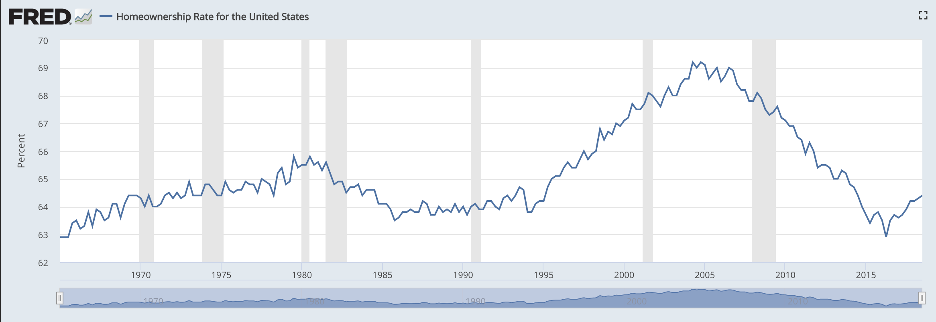


Introduction
1
2
3
1, 2, 3
Notes:
So why this topic?
Adam and I live in Portland and San Francisco. We’re regularly exposed to headlines, conversation, and concern about home and rental prices increasing as hipsters re-urbanize into trendy towns and successful tech companies do the same.
And you don’t need to search the web far to find that the chatter around most of the country is actually similar. You may have seen headlines recently like the ones on this slide that claim that housing prices are rising faster than inflation and wages or that we’re in the middle of ‘housing crisis’ nationwide with eviction on the rise as well. The graph on this slide from the Federal Reserve Bank of St. Louis shows that the number of households in the U.S. that are owner occupied recently hit its lowest rate in the last half century.
So we wanted to take a look at some of these figures ourselves and test a few hypotheses. And we got our hands on a rich database from realtor.com and a new eviction database (the one mentioned in the NPR article above) to do just that.

Slide 3
Questions
Our Analytic Approach
How does regional home affordability relate to regional rental affordability?
How does eviction rate change with changes in cost of rent?
Start with hypotheses — real estate axioms or economics “common sense”
Filter and build dataframe that allows the most meaning to be extracted
Analyze relationships between variables of interest graphically and numerically
Confirm or bust hypothesis
Share the results
Notes:
Two general question about home and rental affordability and their impact on eviction guided our investigation. The first question, which I’ll pass off to Adam to discuss in more detail in a minute, asks, “How does regional home affordability relate to regional rental affordability?” And the second question is, “How does eviction rate change with changes in cost of rent?”
Our analytical approach sought to answer these questions with 5 general steps. Like proper scientists, we started off with hypotheses to test, and these hypotheses were real estate axioms or economic relationships that Adam and I (both PhD.s in real estate economics… not really) both thought seemed sensical. From our hypotheses, we turned to our data, filtered it, added series to it, and squeezed it into dataframes we could extract meaningful findings from. We then used matplotlib to analyze and visualize our data, and like the Mythbusters, confirm or bust our hypotheses. And now we’re here with you and our drinks sharing the results.

Slide 4
Data Limitations & Assumptions
Question 1
No common location category between Realtor & Eviction datasets. For this reason, a decoder ring was made to join on counties (Realtor) that are wholly cities (Eviction).
Cost-of-living variables, such as property tax burden, are not captured in data set.
Question 2
Median gross rent and median household income update quinquennially, except for between 2009-11, so we observe relationship in this window
Filtered out metropolitan areas with population > 100,000 due to concentrate analysis on areas where volatility wasn’t super high due to low number
Notes:
Before we get into analysis, we’ll mention of few limitations in our data and assumptions we made.
For question 1, the closest the data would come to matching on a location index was between cities and counties. As most cities wholly own their counties, we joined on this relationship. This limits the number of cities that can be analyzed in the absence of expanding the project scope. Otherwise, cost-of-living variables other than rent and home prices would be valuable for this analysis. For instance, property taxes can vary by ~$5k per year for a $350k property in different states.
For question 2, we’re asking a question about velocities, or two variables relationships as they change across time. Unfortunately, in our dataset, median rent and median income came from the census, which runs every five years, while eviction rate data was available annually... except, lucky for us, between 2009-2011 when all this data was available annually. We focused on this period because of that and also reduced our dataset to locations where population greater than 100,000 to limit volatility in these YoY changes.

Slide 5
Hypothesis 1:
Regions where home ownership is relatively expensive will be relatively less affordable for renters. This will manifest in a higher rates of rental and rental eviction rates.
Notes:
Hypothesis 1 follows a perceived path of difficulty building wealth. Expensive houses and low wages drive up rent demand which drives rent prices higher. This would ultimately result in people not being able to afford their rent and being evicted from their apartment.
Quick note, cost of rent is what it sounds like -- how much you pay for rent. Eviction rate is the percentage of rental households that have received an eviction judgement.

Slide 6
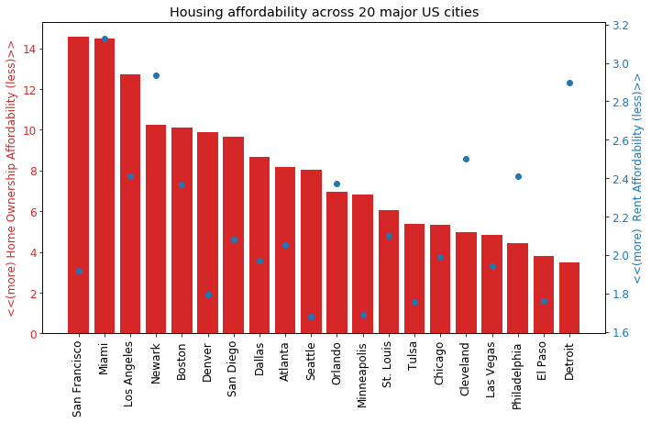
Rent affordability shows little relation to Home Ownership affordability on the aggregate
Notes:
To create this graph showing housing affordability across 20 major US cities, it was necessary to create metrics for home ownership affordability as Median Listing Price / Median Income. Rent Affordability is a similar metric for rent, however using Median Rental Cost. In either case, a low value indicates more affordable housing.
Red bars for home ownership affordability correspond to red axis on the left
Blue scatter for rent affordability correspond to second blue axis on the right
The first part of our hypothesis was that Home Ownership and Renting would be similarly affordable. However, the scatter of the rent affordability shows this hypothesis was incorrect.

Slide 7
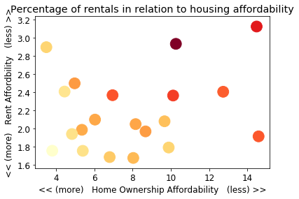
Miami
Newark
Detroit
Percentage of rentals +
San Francisco
Renting is more prevalent in areas where home ownership is less affordable.
Notes:
The plot highlights percentage of rentals as the darkening shades of red. The dots represent the 20 cities shown in previous graph. There is a clear trend here of less affordable housing leading to higher rates of rental, which is in line with our hypothesis that rental demand and affordability issues would increase as home ownership becomes less affordable.

Slide 8
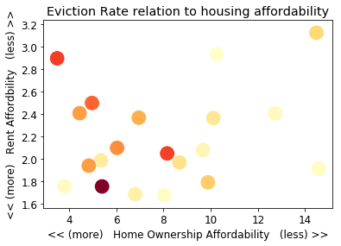
Miami
Newark
Detroit
Eviction Rate +
San Francisco
Eviction rates are higher in areas with more affordable housing.
Notes:
The plot behaves similar to the previous plot, except the heat value is now Eviction Rate. Evictions are consistently higher in areas with more affordable housing. This is not in line with expectations in our hypothesis.

Slide 9
Hypothesis 2:
When cost of rent changes, eviction rate changes proportionately in the same direction
Notes:
Hypothesis 2 simply states: when cost of rent changes, eviction rate changes proportionately in the same direction. So a positive correlation, not unlike the the icon pictured at the top right.
The intuition here is that is that big changes in YoY rental rate should be associated with big changes in YoY eviction rate because being able to afford rent is a key factor in being able to stay in your rental unit.

Slide 10
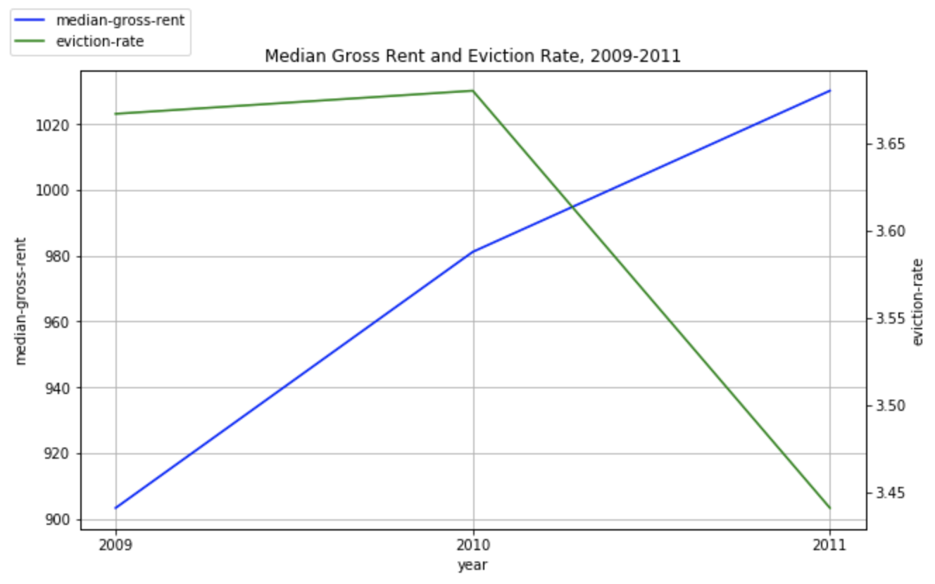
Median gross rent increased steadily over this period; eviction rate increases first year and then sharply dipped in 2011
Notes:
Here’s an inconclusive, but interesting, graph to start us off. This shows gross rent, in blue, is increasing across the country in cities with more than 100,000 people between 2009 and 2011. Eviction rates, in green, also increase between 2009 and 2010, but decrease between 2010 and 2011. For some added context, the average change in eviction rate between 2000 and 2016 was roughly -2% and this decrease between 2010 and 2011 (-6.5%) represents nearly 3.5 times that average decrease… so a good year for eviction! But not what our hypothesis expects. So this raises an eyebrow, but we’ll look further.

Slide 11
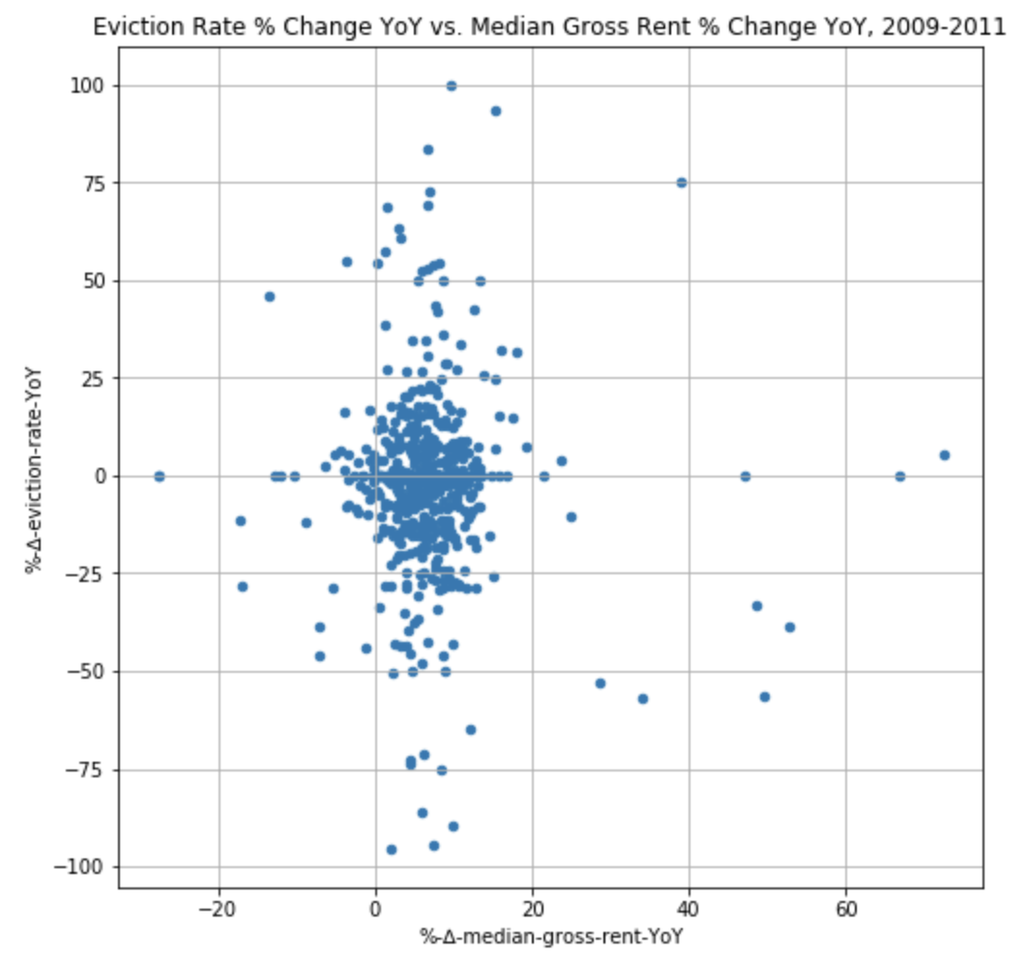
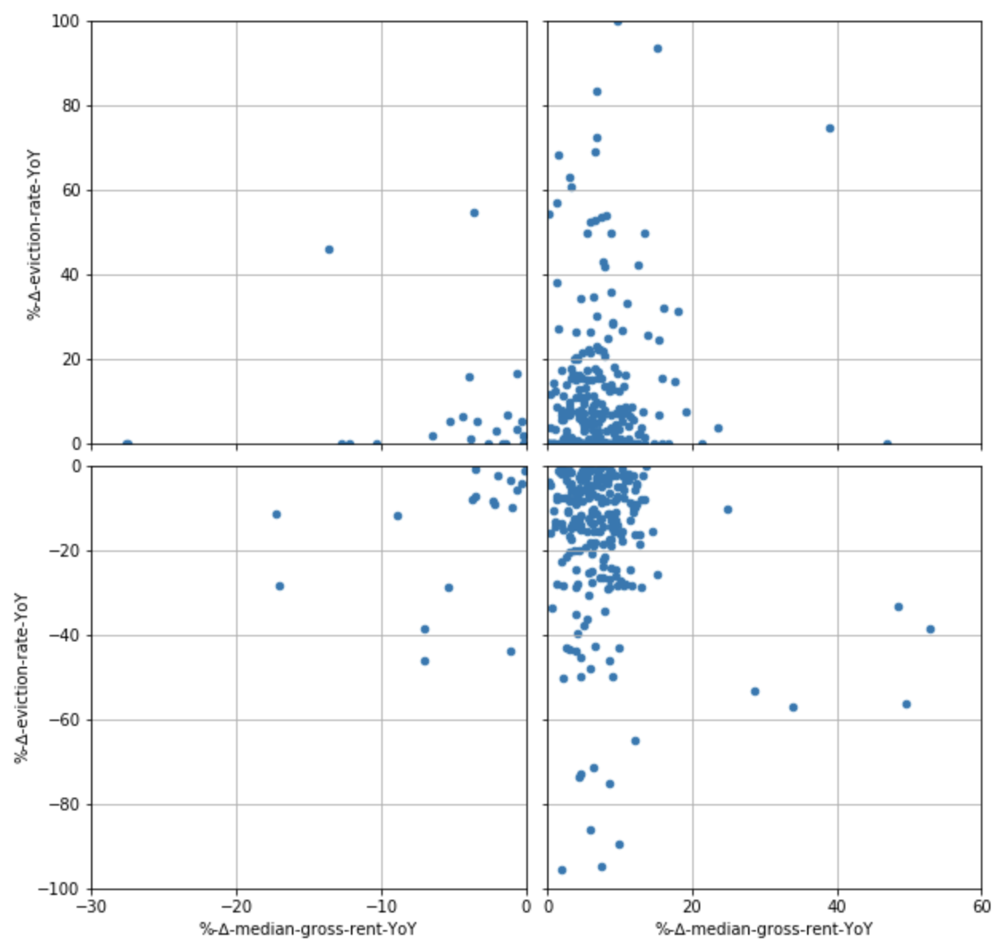
While YoY median gross rent generally increases, YoY eviction rates didn’t tend to increase or decrease
Notes:
The graphs here plot a point for each metro area and each year change in our time window (so 2). They convey a similar story as our line graph a slide ago: YoY median gross rent (on x-axis) is increasing during this time period, but YoY eviction rate (y-axis) seems evenly distributed across the x-axis -- that is to say, it’s not consistently increasing or decreasing. This is bad news for hypothesis but good news for learning.

Slide 12
6.5%
93%
-1.9%
53%
Average YoY ∆ Median Gross Rent
Positive % ∆ Median Gross Rent
Average YoY ∆ Eviction Rate
Positive % ∆ Eviction Rate
Notes:
To represent this numerically, but without getting into the more rigorous stats I’m hoping to learn next semester, the average YoY change in median rent over this time was 6.5% while the average YoY change in eviction rate was just above -2%. And the percent of metro areas that saw an increase in YoY median gross rent was 93%; the analogous figure for YoY eviction rate was 53%.
So we feel safe to call hypothesis 2 busted. And we’ll admit, maybe that it was naive. We didn’t take into account change in income, for example, during those years. We’d likely do better with a hypothesis that says that if rent increases YoY but YoY income change is negative or low, then eviction rate will increase, or vice versa.

Slide 13
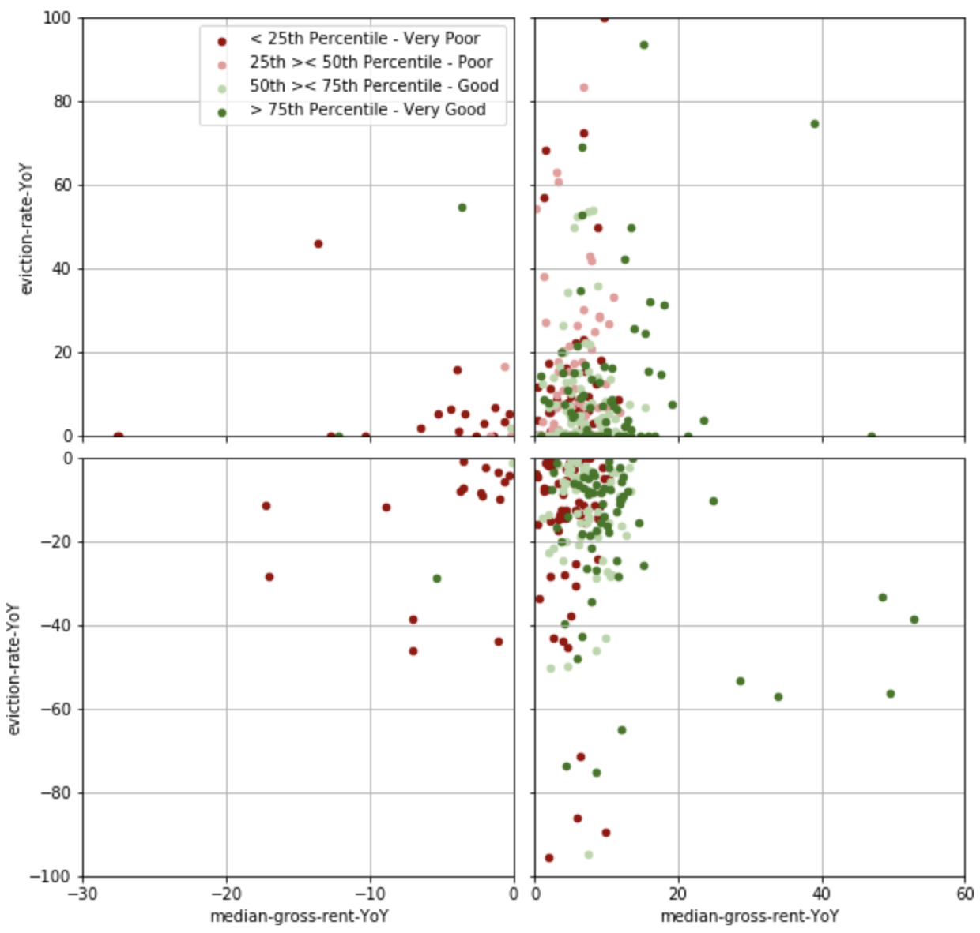
median-household-income-YoY-categories | % Cases in which Eviction Rate Increased
< 25th percentile -- very poor | 46%
25th >< 50th percentile -- poor | 53%
50th >< 75th percentile -- good | 57%
> 75th percentile -- very good | 56%
Metro areas with poor ∆s in YoY income less likely to see eviction rate increase than areas with good YoY ∆ in income
Notes:
To give that rejuvenated hypothesis a whirl, we made this Christmas-themed scatter plot. And without going into the details, the hypothesis suggests that we would see more red in the top two quadrants and more green in the bottom two quadrants. And alas… we actually see the opposite, if anything. Groups in the bottom quartile of YoY median household rent change saw their eviction rate actually decrease more frequently and groups in the top two quartiles of YoY changes in household income saw their eviction rate increase more frequently. That was a lot -- back to Adam to rearticulate our conclusions.

Slide 14
Conclusion
Hypothesis 1: Partial
Regions where home ownership is relatively expensive will be relatively less affordable for renters (disproven). This will manifest in a higher rates of rental (supported) and rental eviction rates (disproven).
Hypothesis 2: Rejected
Changes in rent are not positively correlated with changes in eviction rate between 2009-11. Changes in income also don’t correlate in the expected direction with changes in eviction rate.
Notes:
Hypothesis 1 is only partially upheld. There is not an apparent relationship between affordability of home ownership and rent by region. Rental rates are higher where home ownership is less affordable, however evictions do not map to less affordable areas.
Hypothesis 2 is rejected. The positive correlation between changes in median gross rent and changes in eviction rate did not emerge. Additionally, strong positive change in income were also not positively correlated with reduction in eviction rate, but poor changes in income were actually more often associated with reduction in eviction rate.
We found it quite interesting from a content perspective to actually look at data to challenge held beliefs. Thank you Gunnar for helping us build these skills.

Slide 15
Thank you! Questions?
Notes:
Hypothesis 2 simply states: when cost of rent changes, eviction rate changes proportionately in the same direction. So a positive correlation, not unlike the the icon pictured at the top right.
The intuition here is that is that big changes in YoY rental rate should be associated with big changes in YoY eviction rate because being able to afford rent is a key factor in being able to stay in your rental unit.

